Slide 1
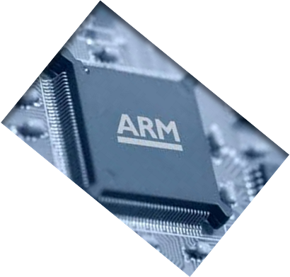

MICROPROCESSOR AND COMPUTER ARCHITECTURE
CACHE
PERFORMANCE
Credits:
MPCA Team
Notes:
1

Slide 2



Cache performance
The Processor Performance Equation
Notes:
10-03-2020
2

Slide 3
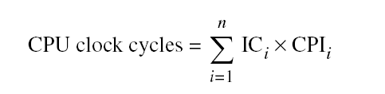
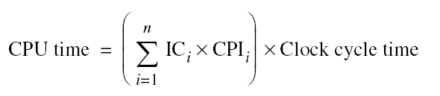
Cache performance
Different instruction types having different CPIs
One method to evaluate cache performance is to expand processor execution time, i.e. Instruction count - IC.
Add memory stall cycles - the number of cycles during which the processor is waiting for a memory access.
CPU Execution = (CPU clock cycles + Memory stall cycles) x Clock cycle execution time
Notes:
10-03-2020
3

Slide 4
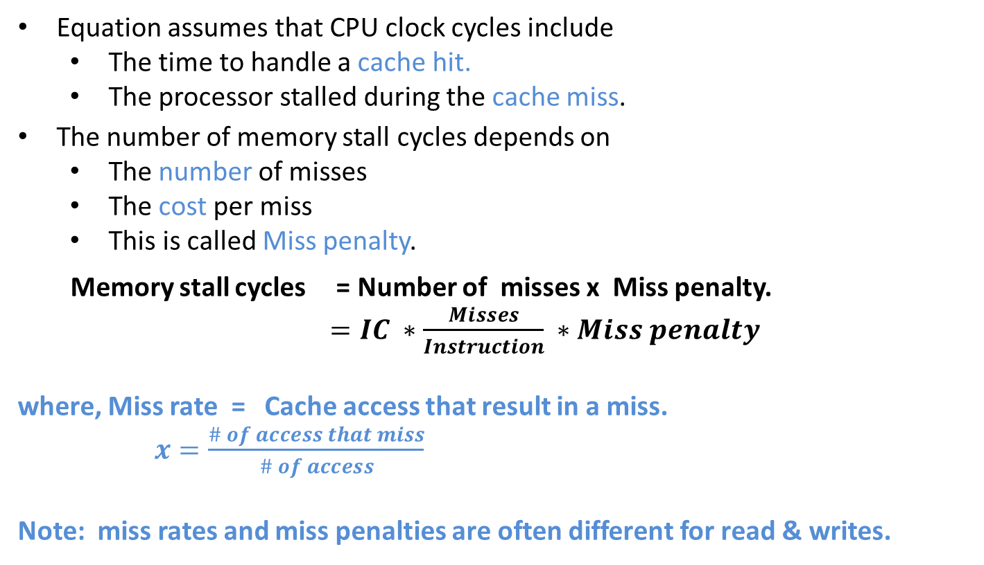
Cache performance
Notes:
10-03-2020
4

Slide 5
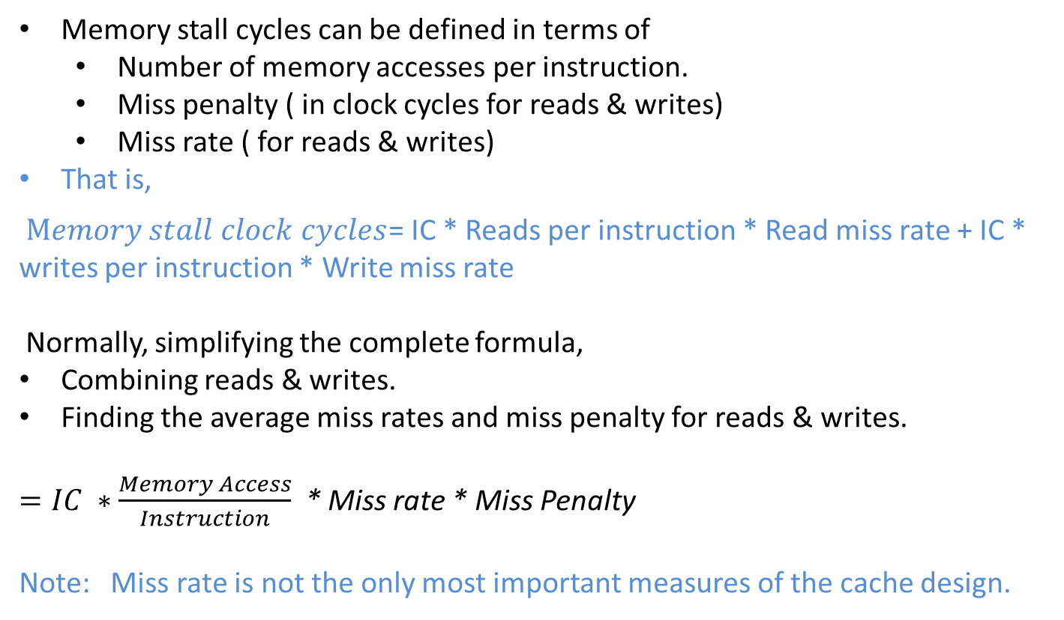
Cache performance
Notes:
10-03-2020
5

Slide 6
Cache performance – example 1
Assume we have a computer where the cycles per instruction (CPI) is 1.0 when all memory accesses hit in the cache. The only data accesses are loads and stores, and these total 50% of the instructions. If the miss penalty is 25 clock cycles and the miss rate is 2%, how much faster would the computer be if all instructions were cache hits?
SOLUTION:
First compute the performance for the computer that always hits:
CPU execution time = ( CPU clock cycles + Memory stall cycles) × Clock cycle
= ( IC × CPI + 0) × Clock cycle = IC × 1.0 × Clock cycle
Now for the computer with the real cache, first we compute memory stall cycles:
Notes:
10-03-2020
6

Slide 7
Cache performance – example 1
where the middle term (1 + 0.5) represents one instruction access and 0.5 data accesses per instruction. The total performance is thus
CPU execution time cache = (IC × 1.0 + IC × 0.75) × Clock cycle
= 1.75 × IC × Clock cycle
The performance ratio is the inverse of the execution times:
Hence, The computer with no cache misses is 1.75 times faster.
Notes:
10-03-2020
7

Slide 8
Cache performance
CPU performance is measured by
Instruction Count
Miss Rate
Both independent of hardware
A better measure of memory hierarchy performance is - Average memory access time.
Average memory access time = Hit time + Miss rate x Miss penalty.
where Hit time – Time to hit in the cache.
The components of a average access time can be measured either as
Absolute time on a hit, say, 0.25 to 1.0 ns.
Number of clock cycles that the processor waits for the memory, such as 150 to 200 clock cycles.
Note:
Average memory access time is still an indirect measure of performance., although, better measure than miss rate.
This formula can help to decide between spilt cache and a unified cache.

Slide 9
Cache performance
CPU time = [CPU execution clock cycles + Memory stall clock cycles] x Clock cycle time.
The equation has a question:
Clock cycles for a cache hit should be considered part of
CPU execution clock cycles? or
Memory stall clock cycles?
Most widely accepted, is to include in CPU execution clock cycles.

Slide 10
Cache performance – example 2
Assume that the cache miss penalty is 200 clock cycles, and all instructions normally take 1.0 clock cycles (ignoring memory stalls). Assume that the average miss rate is 2%, there is an average of 1.5 memory references per instruction, and the average number of cache misses per 1000 instructions is 30. What is the impact on performance when behavior of the cache is included? Calculate the impact using both misses per instruction and miss rate.
SOLUTION:
CPU_{time} = IC x [ CPI _{execution} + Memory stall clock cycles per instructon ] x Clock cycle time
The performance, including cache misses, is
CPU time _{with Cache} = IC x [ 1.0 + ( 30/1000 x 200) x Clock cycle time
= IC x 7.00 x Clock cycle time.
The clock cycle time and instruction count are the same, with or without a cache. Thus CPU time increases sevenfold, with CPI from 1.00 for a perfect cache to 7.00 with cache that can miss.
Notes:
10-03-2020
10

Slide 11
Cache Optimizations
The equation,
Average memory access time = Hit time + Miss rate x Miss penalty.
Gives a frame work to present cache optimizations for improving cache performance. Hence, six basic cache optimizations can be organized into three categories.
Reducing the miss rate
Larger block size, Larger cache size, and higher associativity.
Reducing the miss penalty
Multilevel caches and giving reads priority over the writes.
Reducing the time to hit in the cache
Avoiding address translation when indexing the cache.
Notes:
10-03-2020
11

Slide 12
Cache Optimizations
The classical approach to improve cache behaviour is to reduce miss rates.
Three categories misses are:
Compulsory :
The very first access to block cannot be in the cache. So, the block must be brought into the cache.
These are called cold-start misses or first reference misses.
Capacity:
If the cache cannot contain all the blocks needed during execution of a program, capacity misses [ in addition to compulsory misses] will occur because of blocks being discarded and later retrieved.
Notes:
10-03-2020
12

Slide 13
Cache Optimizations
Three categories misses are:
Conflict:
If the block placement strategy is set associative or direct mapped, conflict misses [in addition to compulsory and capacity misses ] will occur because a block may be discarded and later retrieved if too many blocks map to its set. These misses are also called collision misses.
The idea is that hits in a fully associative cache that become misses in an n-way set associative cache, due to more than n requests on some popular sets.
NOTE: Further adding a 4th C , for coherence misses due to flushes to keep multiple caches coherent in a multiprocessor environment.
Notes:
10-03-2020
13

Slide 14
Cache Optimizations
Compulsory Misses :
Those that occur in an infinite cache.
Capacity Misses:
Those that occur in a fully associative cache.
Conflict Misses:
Those that occur going from fully associative to eight-way associative, four–way associative , and so on…
To show the benefit of associativity, conflict misses are divided into misses caused by each decrease in associativity.
Here are the four divisions of conflict misses and how they are calculated:
■ Eight-way—Conflict misses due to going from fully associative to eight-way associative
■ Four-way—Conflict misses due to going from eight-way associative to four way associative
■ Two-way—Conflict misses due to going from four-way associative to two way associative
■ One-way—Conflict misses due to going from two-way associative to one way associative
Notes:
10-03-2020
14

Slide 15
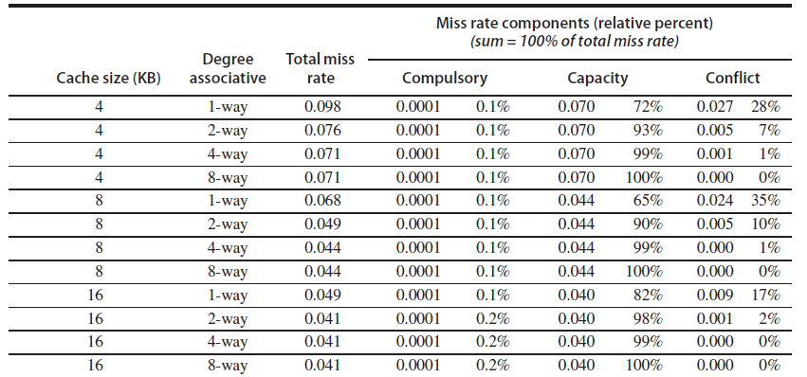
Cache Optimizations
Conceptually, conflicts are the easiest:
Fully associative placement avoids all conflict misses,
Expensive in hardware and
May slow down the processor clock rate leads to lower overall performance.
Notes:
10-03-2020
15

Slide 16
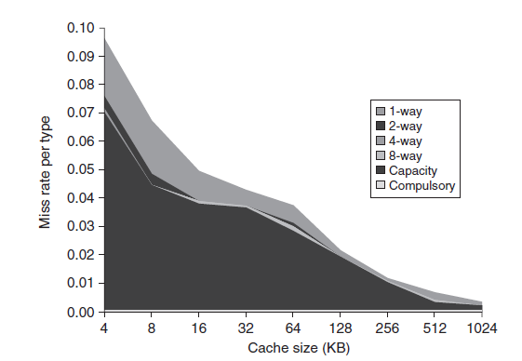
Cache Optimizations
Notes:
10-03-2020
16

Slide 17
6 Basic Cache Optimizations
First Optimization: Larger Block Size to Reduce Miss Rate.
Second Optimization: Larger Caches to Reduce Miss Rate.
Third Optimization: Higher Associativity to Reduce Miss Rate.
Fourth Optimization : Multilevel Caches to Reduce Miss Penalty.
Fifth Optimization: Giving Priority to Read Misses over Writes to Reduce Miss Penalty.
Sixth Optimization: Avoiding Address Translation during Indexing of the Cache to Reduce Hit Time.
Notes:
10-03-2020
17

Slide 18
Q & A
Cache Optimizations
Notes:
10-03-2020
18

